Slide 1


PREDICTIVE ANALYTICS WITH MACHINE LEARNING

Slide 2

Project Overview
In this project, we’ll apply machine learning regression techniques to predict units sold from supplement sales based on various factors such as price, location, and discounts.
We will focus on understanding the workflow to build machine learning regression models in a typical data science project.
Model Inputs
Date
Product Name
Category
Price
Discount
Location
Model Output
© All rights reserved for Dr. Ryan Ahmed @Stemplicity Inc.
Machine Learning Regression Model
Units Sold

Slide 3
Project Steps
1. Load and Inspect: the supplement sales dataset (Supplement_Sales_Weekly_Expanded.csv).
2. Handle Missing Values: Demonstrate imputation techniques.
3. Perform Exploratory Data Analysis (EDA) to understand the data's structure, distributions, and relationships using statistics and visualizations.
4. Preprocess the Data: Clean the data, handle categorical features (like Product Category, Location), & split the data for model training & testing.
5. Build and Train a Linear Regression Model: Our first simple regression model.
6. Build and Train a Random Forest Regression Model: A more complex, tree-based ensemble model.
7. Evaluate both models using standard regression metrics (like R-squared, MAE, MSE) & compare their performance.
© All rights reserved for Dr. Ryan Ahmed @Stemplicity Inc.

Slide 4

Key Learning Outcomes
Load, inspect, and understand the structure of the dataset.
Handle missing values using appropriate imputation techniques.
Perform exploratory data analysis (EDA) and preprocess data, including cleaning and encoding categorical features.
Train both linear regression and random forest models to predict sales.
Evaluate and compare model performance using metrics like R², MAE, and MSE.
© All rights reserved for Dr. Ryan Ahmed @Stemplicity Inc.

Slide 5
MACHINE LEARNING REGRESSION 101

Slide 6
Machine Learning Regression 101
Machine Learning Regression focuses on predicting continuous numerical values.
In business, understanding the factors that drive revenue is critical for strategic growth.
By developing regression models, businesses can:
Identify key drivers of sales (e.g., which product categories sell best, impact of discounts).
Potentially forecast future revenue based on planned promotions or product launches.
Gain insights into customer behavior across different locations and platforms.
© All rights reserved for Dr. Ryan Ahmed @Stemplicity Inc.

Slide 7




Simple Linear Regression
In simple linear regression, we predict the value of one variable, Y, based on another variable, X, where X is called the independent variable and Y is called the dependent variable.
It is called simple because it examines the relationship between two variables only.
Y-Intercept
$800,000
Slope
$$Y=b+m∗X$$
© All rights reserved for Dr. Ryan Ahmed @Stemplicity Inc.
House Price ($)
$$Slope=m$$
Dependent Variable
Independent Variable
$$b$$
2000 sqft
House Size (Sq. ft.)

Slide 8
Multiple Linear Regression
Multiple Linear Regression examines the relationship between more than two variables.
Each independent variable has its own corresponding coefficient.
Model Coefficients
$$Y=b_{0}+b_{1}∗X_{1}+b_{2}∗X_{2}+..+b_{n}X_{n}$$
© All rights reserved for Dr. Ryan Ahmed @Stemplicity Inc.
Dependent Variable (House Price)
Independent Variables (House Size, Number of Bedrooms, Number of Bathrooms..etc.)

Slide 9
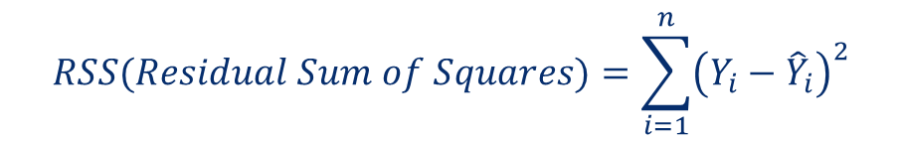




Least Squares Method
The least squares method is a widely used approach in regression analysis to estimate the coefficients of a linear regression model.
The goal of this method is to find the best-fit line through a set of data points.
The regression coefficients are chosen to minimize the Residual Sum of Squares (RSS) (i.e., the sum of the squared difference between actual values ($Y_{i}$) and predicted values (${\hat{Y}}_{i})$.
$$RSS(Residual Sum of Squares)=\sum_{i=1}^{n}{{\left(Y_{i}−{\hat{Y}}_{i}\right)}^{2}}$$
$Y_{i}$ (actual)
© All rights reserved for Dr. Ryan Ahmed @Stemplicity Inc.
$$error$$
House Price ($)
${\hat{Y}}_{i}$(estimated)
House Size (Sq. ft.)

Slide 10
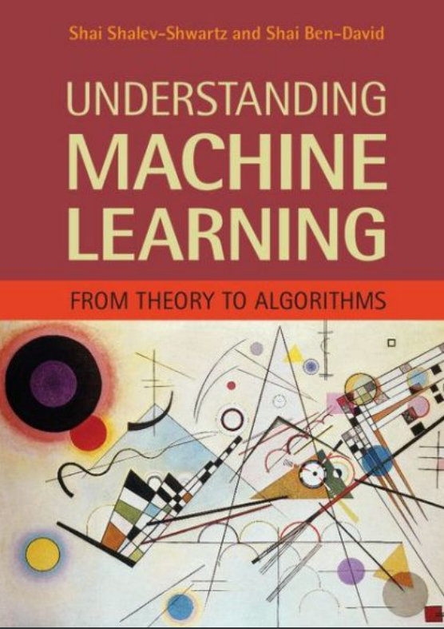
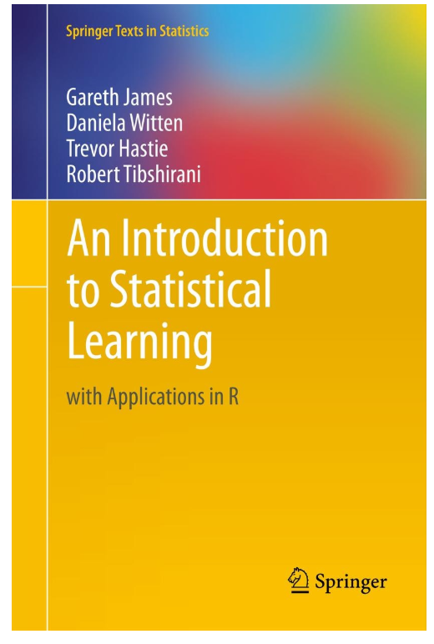
Simple Linear Regression: Reading Materials
Additional Resources, Page #123: http://www.cs.huji.ac.il/~shais/UnderstandingMachineLearning/understanding-machine-learning-theory-algorithms.pdf
Additional Resources, Page #61: http://www-bcf.usc.edu/~gareth/ISL/ISLR%20Seventh%20Printing.pdf
© All rights reserved for Dr. Ryan Ahmed @Stemplicity Inc.

Slide 11
PRACTICE OPPORTUNITY

Slide 12


Practice Opportunity
Can you draw these equations?
$$y=3∗x$$
$$y=15−10∗x$$
© All rights reserved for Dr. Ryan Ahmed @Stemplicity Inc.

Slide 13




Practice Opportunity Solution
Can you draw these equations?
$$y=3∗x$$
$$y=15−10∗x$$
$$y$$
© All rights reserved for Dr. Ryan Ahmed @Stemplicity Inc.
$$y$$
$$x$$
$$x$$

Slide 14
MACHINE LEARNING REGRESSION METRICS

Slide 15


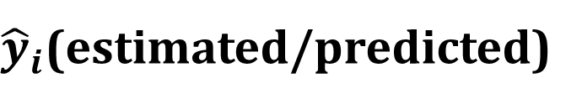
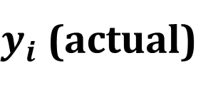
Regression Metrics
After model fitting, we would like to assess the performance of the model by comparing model predictions to actual (True) data
$$Residuals (Error)={\hat{y}}_{i}−y_{i}$$
$y_{i}$ (actual)
$$Error$$
Revenue($)
${\hat{y}}_{i}$(estimated/predicted)
© All rights reserved for Dr. Ryan Ahmed @Stemplicity Inc.
Temperature (degC)
Source: https://www.goodfreephotos.com/vector-images/ice-cream-stand-vector-clipart.png.php

Slide 16

Regression Metrics: Mean Absolute Error (MAE)
Mean Absolute Error (MAE) is obtained by calculating the absolute difference between the model predictions and the true (actual) values
MAE is a measure of the average magnitude of error generated by the regression model
The mean absolute error (MAE) is calculated as follows:
$$MAE=\frac{1}{n}\sum_{i=1}^{n}{|y_{i}−{\hat{y}}_{i}|}$$
MAE is calculated by following these steps:
Calculate the residual of every data point
Calculate the absolute value (to get rid of the sign)
Calculate the average of all residuals
© All rights reserved for Dr. Ryan Ahmed @Stemplicity Inc.

Slide 17

Regression Metrics: Mean Square Error (MSE)
Mean Square Error (MSE) is very similar to the Mean Absolute Error (MAE) but instead of using absolute values, squares of the difference between the model predictions and the training dataset (true values) is being calculated.
MSE is usually larger compared to the MAE since the residuals are being squared.
In case of data outliers, MSE will become much larger compared to MAE.
In MSE, since the error is being squared, any predicting error is being heavily penalized.
$$MSE=\frac{1}{n}\sum_{i=1}^{n}{{\left(y_{i}−{\hat{y}}_{i}\right)}^{2}}$$
MSE is calculated by following these steps:
Calculate the residual for every data point
Calculate the squared value of the residuals
Calculate the average of results from step 2
© All rights reserved for Dr. Ryan Ahmed @Stemplicity Inc.

Slide 18

Regression Metrics: Root Mean Square Error (RMSE)
Root Mean Square Error (RMSE) represents the standard deviation of the residuals (i.e.: differences between the model predictions and the true values (training data)).
RMSE is easily interpreted compared to MSE because RMSE units match the units of the output.
The RMSE is calculated as follows:
$$RMSE=\sqrt{\frac{1}{n}\sum_{i=1}^{n}{{\left(y_{i}−{\hat{y}}_{i}\right)}^{2}}}$$
RMSE is calculated by following these steps:
Calculate the residual for every data point
Calculate the squared value of the residuals
Calculate the average of the squared residuals
Obtain the square root of the result
© All rights reserved for Dr. Ryan Ahmed @Stemplicity Inc.

Slide 19

Regression Metrics: Mean Absolute Percentage Error (MAPE)
MAE values can range from 0 to infinity which makes it difficult to interpret the result as compared to the training data.
Mean Absolute Percentage Error (MAPE) is the equivalent to MAE but provides the error in a percentage form and therefore overcomes MAE limitations.
MAPE might exhibit some limitations if the data point value is zero (since there is division operation involved).
The MAPE is calculated as follows:
$$MAPE=\frac{100\%}{n}\sum_{i=1}^{n}{|(y_{i}−{\hat{y}}_{i})/y_{i}|}$$
© All rights reserved for Dr. Ryan Ahmed @Stemplicity Inc.

Slide 20

Regression Metrics: R Square ($R^{2}$)
R-square or the coefficient of determination represents the proportion of variance (of y) that has been explained by the independent variables in the model.
If $R^{2}=80$, this means that 80% of the increase in ice cream cart revenue is due to increase in temperature.
© All rights reserved for Dr. Ryan Ahmed @Stemplicity Inc.
Revenue($)
Temperature (degC)
Source: https://www.goodfreephotos.com/vector-images/ice-cream-stand-vector-clipart.png.php

Slide 21

Regression Metrics: R Square ($R^{2}$)
R-square represents the proportion of variance of the dependant variable (y) that has been explained by the independent variables.
R-square provides an insight of goodness of fit.
It gives a measure of how well unseen samples are likely to be predicted by the model, through the proportion of explained variance.
Maximum $R^{2}$ value is 1
A constant model that always predicts the expected value of y, disregarding the input features, will have an R² score of 0.0.
$$R^{2}=1−\frac{\sum_{i=1}^{n}{{\left(y_{i}−{\hat{y}}_{i}\right)}^{2}}}{\sum_{i=1}^{n}{{\left(y_{i}−\overline{y}\right)}^{2}}}$$
© All rights reserved for Dr. Ryan Ahmed @Stemplicity Inc.

Slide 22
PANDAS 101 & DATA VISUALIZATION

Slide 23


What is Pandas?
Pandas is a powerful Python library for data analysis and manipulation, widely used in data science, machine learning, and analytics.
Why Use Pandas?
Simplifies working with large datasets.
Flexible and fast for complex operations.
Widely supported in Python's data science ecosystem.
© All rights reserved for Dr. Ryan Ahmed @Stemplicity Inc.

Slide 24
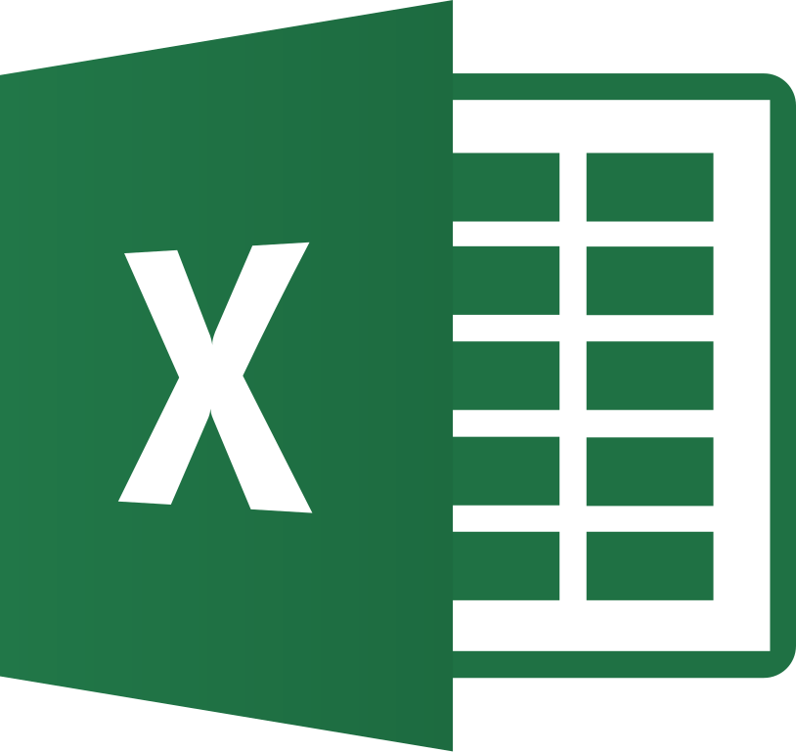
Pandas Vs. Excel
Feature | Excel | Pandas
Platform | GUI-based spreadsheet application | Python-based programming library
Data Size | Limited by Excel's rows/columns limits | Handles large datasets efficiently
Automation | Requires manual effort or VBA macros | Fully scriptable with Python
Speed | Slower for large datasets or calculations | Fast with optimized operations
Reproducibility | Manual steps; hard to document | Code-driven; easy to reproduce results
Complex Analysis | Limited advanced tools | Built-in advanced data manipulation
Integration | Limited to Excel-supported formats | Supports many formats (CSV, SQL, JSON)
Visualization | Built-in charting tools | Integrates with Matplotlib/Seaborn
© All rights reserved for Dr. Ryan Ahmed @Stemplicity Inc.

Slide 25
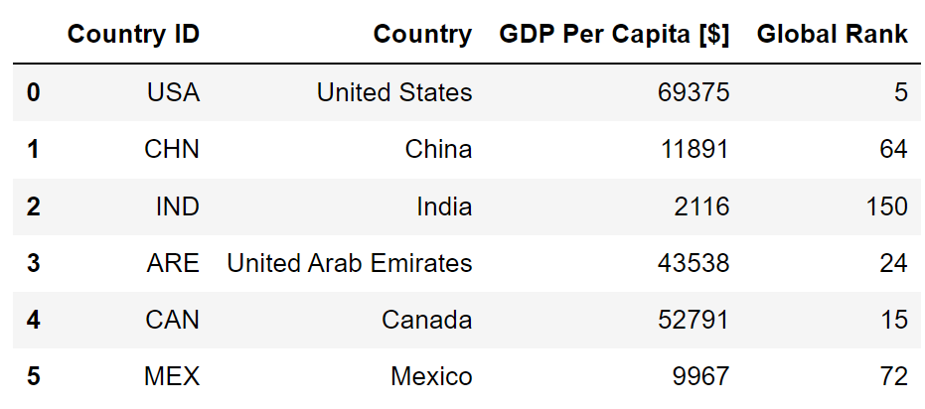
Pandas DataFrames
Pandas DataFrame is a 2-dimensional, tabular data structure in the Python library Pandas.
It is like a spreadsheet or SQL table and is the most used tool in data analysis & manipulation.
Column Names
Data
Index/Label
© All rights reserved for Dr. Ryan Ahmed @Stemplicity Inc.

Slide 26
Pandas DataFrames Features
Heterogeneous: Columns store different data types (e.g., numbers, strings, dates).
Powerful Operations: Enables filtering, aggregation, & analysis.
Tabular Format: Organized into rows (index) and columns (labels), like a spreadsheet.
Data Sources: Supports input from CSV, Excel, SQL.
Labeled Indexing: Access data easily using labels or positions.
© All rights reserved for Dr. Ryan Ahmed @Stemplicity Inc.

Slide 27



Popular Data Visualization Libraries
Python offers many libraries for data visualization such as Matplotlib, Seaborn, and Plotly.
Grandfather of data visualization libraries.
It creates static & interactive visualizations.
Link: https://matplotlib.org/
Based on Matplotlib & offers enhanced features.
Generates aesthetically appealing statistical plots.
Link: https://seaborn.pydata.org/
Plotly creates interactive charts using few code lines.
Offers 40+ chart types (statistical, financial & scientific).
Link: https://plotly.com/python/
© All rights reserved for Dr. Ryan Ahmed @Stemplicity Inc.

Slide 28
DATA SPLIT IN MACHINE LEARNING

Slide 29
Data Split: Training Vs. Testing
In machine learning, the objective is to train a model that can generate accurate predictions on unseen data.
The simplest method is to divide the available dataset into two subsets:
Training subset: used to train the model
Testing (holdout) subset: used to evaluate the final performance of the trained model. Testing subset has never been seen by the model during training.
Training
80%
Available Dataset
© All rights reserved for Dr. Ryan Ahmed @Stemplicity Inc.
Testing
20%

Slide 30
Data Split: Training Vs. Testing Vs. Validation
In some situations, the available dataset is split into 3 subsets:
Training subset: used to train the model
Validation (cross-validation) subset: used to tune the model hyperparameters and to evaluate the training process quality as training proceeds.
Testing (holdout) subset: used to evaluate the final performance of the trained model. Testing subset has never been seen by the model during training.
Training
60%
Available Dataset
Validation
20%
© All rights reserved for Dr. Ryan Ahmed @Stemplicity Inc.
Testing
20%

Slide 31
ONE HOT ENCODING

Slide 32
One-Hot-Encoding
One-hot-encoding works by converting values such as “color” into columns with 1’s and 0’s.
Since machine learning models deal with numbers, we perform one-hot-encoding to convert categorical data into numerical.
COLOR
RED
RED
YELLOW
GREEN
YELLOW
RED | YELLOW | GREEN
1 | 0 | 0
1 | 0 | 0
0 | 1 | 0
0 | 0 | 1
0 | 1 | 0
© All rights reserved for Dr. Ryan Ahmed @Stemplicity Inc.

Slide 33
One-hot-Encoding: Important Note
Can we simply replace colours with integer values? No!
The machine learning model will assume that:
$$GREEN>YELLOW>RED$$
WRONG!
COLOR
RED
RED
YELLOW
GREEN
YELLOW
ENCODED COLOR
1
1
2
3
2
© All rights reserved for Dr. Ryan Ahmed @Stemplicity Inc.

Slide 34

Summary
We learned how to develop and compare regression models (linear regression and random forest) using Scikit-learn, to predict unit sales based on real-world data.
Using Pandas, we handled missing values, cleaned the dataset, and performed data preprocessing such as encoding categorical variables and splitting data.
We evaluated model performance using Scikit-learn’s regression metrics like R², MAE, and MSE, allowing us to assess accuracy, compare models, and draw data-driven conclusions about model effectiveness in a business context.
Matplotlib and Seaborn are powerful libraries that can perform effective exploratory data analysis (EDA) through visualizations to reveal patterns, trends, and correlations.
© All rights reserved for Dr. Ryan Ahmed @Stemplicity Inc.

Slide 35
Thank you!

